Slide 1


Chroma: Learning and Using Network Contexts to
Reinforce Performance Improving Configurations
（ACM MobiCom ’23）
Changhan Ge†, Zihui Ge‡, Xuan Liu‡, Ajay Mahimkar‡, Yusef Shaqalle‡, Yu Xiang‡, Shomik Pathak‡. 2023. Chroma: Learning and Using Network Contexts to Reinforce Performance Improving
Configurations. In The 29th Annual International Conference on Mobile Computing and Networking (ACM MobiCom ’23), October 2–6, 2023, Madrid, Spain.
汇报人：方如意
日期：2024.6.26
知行合一、经世致用
自强不息 厚德载物
自强不息 厚德载物
Tsinghua University of China
Central South University

Slide 2
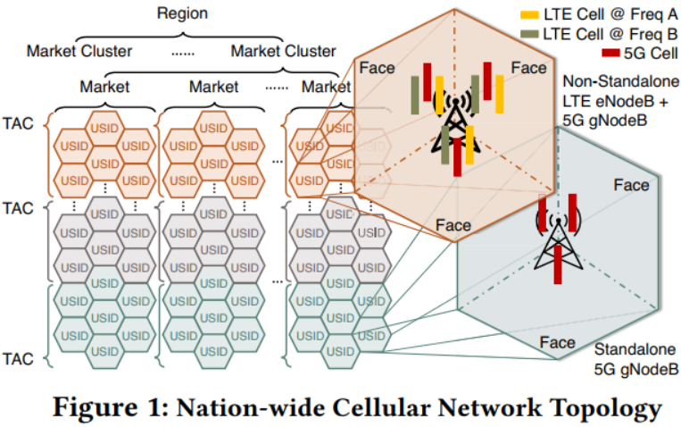
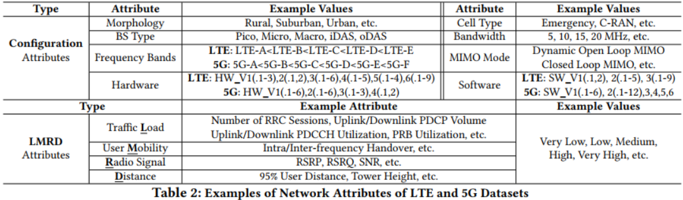
Background and Motivation
Configuration tuning and management plays a pivotal role across all aspects in improving QoS and user experience.
The set of configuration parameters is extremely huge, and the tuning process is deemed as art by the service providers leveraging their domain knowledge and immense experience.
Different configuration settings have the potential to have a different service performance impact.
The same configuration setting can have a contrasting service performance impact across diverse locations.
Which configuration setting can provide an optimal impact tradeoff across different locations?
知行合一、经世致用
自强不息 厚德载物
自强不息 厚德载物
Tsinghua University of China
Central South University

Slide 3
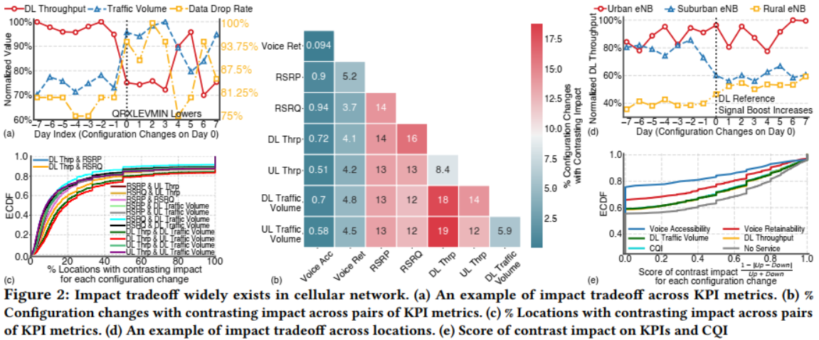
Background and Motivation
Challenges:
Configuration parameter dependency
Performance impact confusion
Uneven distribution during configuration exploration
Configuration parameter assertions
Fig(a): Altering a configuration may improve some key performance indicator (KPI) metrics but negatively impact others.
Fig(b): The prevalence of performance impact tradeoff across pairs of metrics observed across all the configuration changes and nodes in the network.
Fig(c): Different metrics can be impacted in contrasting directions for the same configuration change.
Fig(d): The same configuration change applied at different locations may have different consequences. Fig(e): Configuration changes experience different performance impacts across different locations.
知行合一、经世致用
自强不息 厚德载物
自强不息 厚德载物
Tsinghua University of China
Central South University

Slide 4
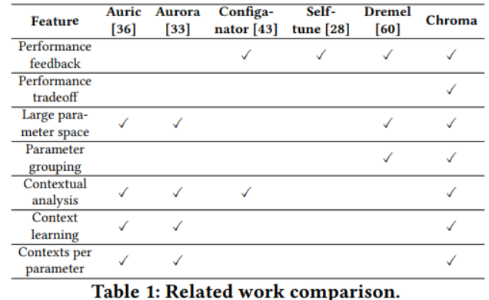
Related work
3GPP SON Technology Shortcomings:
Local Optimization
Single Objective
Operational Complexity
Reinforcement Learning (RL) Shortcomings:
Many Parameters
Long Time Window
Seasonal Variability
Complex Contexts
ignores trade-offs across multiple metrics.
lacking the ability to automatically learn context for
each parameter
3. focuses on single performance metrics
知行合一、经世致用
自强不息 厚德载物
自强不息 厚德载物
Tsinghua University of China
Central South University

Slide 5
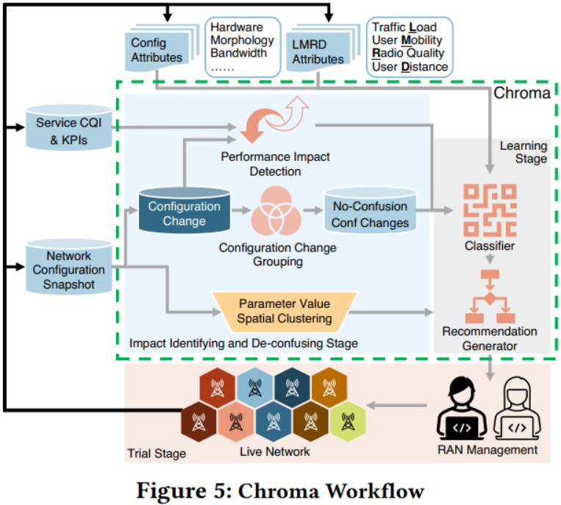
Chroma design and implementation
The Chroma workflow optimizes network configurations through the following steps:
Configuration Change Grouping: Identifying and grouping related configuration changes.
Performance Impact De-confusion: Eliminating the interference of external factors to ensure assessment accuracy.
Performance Impact Classification: Learning and identifying the context of configuration changes and classifying their performance impacts.
Parameter value spatial clustering: find parameter dependencies across time and space
Assertion, recommendation and trial: Generating and validating configuration change recommendations to enhance overall network performance.
知行合一、经世致用
自强不息 厚德载物
自强不息 厚德载物
Tsinghua University of China
Central South University

Slide 6


Chroma design and implementation
(1) Configuration change grouping
Purpose: Learning and identifying the context of configuration changes and classifying their performance impacts.
Grouping Two Configuration Parameters
Grouping Multiple Configuration Parameters
Calculating the posterior probability between Ci and Cj
Constructs an adjacency matrix
Find the largest group in the adjacency matrix by Bron-Kerbosch algorithm.
the Jaccard similarity
metric between O(C𝑖) and O(C𝑗)
A set of parameters that are all highly dependent on each other
G = {C𝑖, · · · , C𝑗}
知行合一、经世致用
自强不息 厚德载物
自强不息 厚德载物
Tsinghua University of China
Central South University
Notes:
学习和识别配置更改的背景，并对其性能影响进行分类。

Slide 7
Chroma design and implementation
(2) Performance Impact Detection and De-confusion
Purpose: To optimize the overall network performance by identifying and grouping related configuration parameters, capturing the dependencies between the parameters, and reducing the confusion of performance impacts due to external factors.
Statistical impact detection:
CQI combines several KPIs (e.g., throughput, latency, data loss rate, etc.) in a weighted manner to provide an overall performance assessment.
Performance impact de-confusion:
Base stations with configuration changes (study group) were compared to base stations without configuration changes (control group).
知行合一、经世致用
自强不息 厚德载物
自强不息 厚德载物
Tsinghua University of China
Central South University
Notes:
通过对相关配置参数进行识别和分组，捕捉参数之间的依赖关系，减少外部因素对性能影响的混淆，从而优化整体网络性能。

Slide 8

Chroma design and implementation
(3) Performance impact classification: learning contexts
Purpose: To identify which set of configuration changes is favorable for which type of cell, it is essential to leverage the classifier that can find the relationship between the network attributes and impact of configuration change.
Subdividing each group of configuration changes (G) into subgroups (Gs)
Expand the dataset by:
conjugate subgroups labeled reversed (-Ys)
missing attribute data (Acs) labeled "uncertain"
Ys:
"increase" category
combining the "decrease", "no effect" and "uncertainty" categories into one
Extract an attribute matrix (As) and corresponding impact labels (Ys)
decision tree classifier
To avoid the overfitting problem of decision trees and instability to data noise
dichotomous tasks
As_rule
Converting branches of a decision tree or RIPPER-generated rulesets into logical clauses of a disambiguation paradigm (DNF)
RIPPER rule learning algorithm
知行合一、经世致用
自强不息 厚德载物
自强不息 厚德载物
Tsinghua University of China
Central South University
Notes:
要确定哪组配置变化对哪类小区有利，就必须利用分类器，找出网络属性与配置变化影响之间的关系。

Slide 9
Chroma design and implementation
(4) Parameter value spatial clustering
Purpose: certain parameter dependencies cannot be discovered using change clustering alone especially when dependent changes may be implemented spanning longer time intervals such as days or only with new feature activations.
Denote S(Ci) as the set of cells that parameter Ci is configured on
Initial clustering is performed using word2vec and k-means
→obtain parent clusters ℭparent
Calculate the mutual information between each pair of parameters, construct the similarity matrix and normalize it
Capture the dependency of value distribution among parameters in each ℭparent
obtain child clusters ℭchild via agglomerative clustering
fetch the list of unique value combinations
知行合一、经世致用
自强不息 厚德载物
自强不息 厚德载物
Tsinghua University of China
Central South University
Notes:
仅使用变化聚类无法发现某些参数的相关性，尤其是当相关变化的实施时间跨度较长（如数天）或仅与新功能激活相关时。

Slide 10
Chroma design and implementation
(5) Assertion, recommendation and trial
Purpose: perform a two-step assertion for the safety of recommendation.
Candidate assertion：
Check the current configuration of the candidate BTSs to ensure that they match the recommended initial state, remove the unmatched candidate BTSs, and generate a new candidate set.
Value dependency assertion ：
Identifies dependencies between configuration parameters, extracts and selects the combination that has the smallest differences from the current configuration and the highest number of occurrences.
知行合一、经世致用
自强不息 厚德载物
自强不息 厚德载物
Tsinghua University of China
Central South University
Notes:
对建议的安全性进行两步论证。

Slide 11
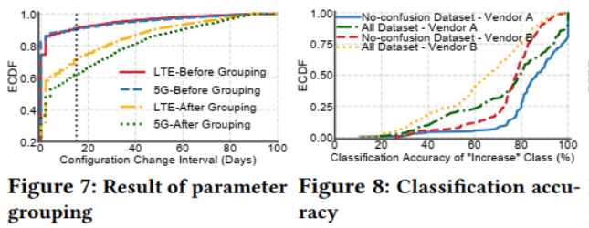
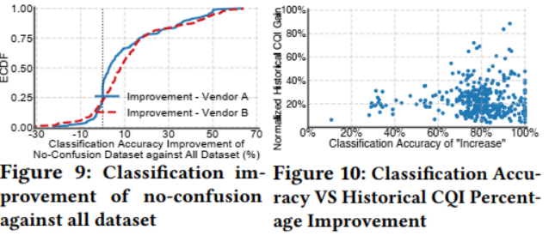
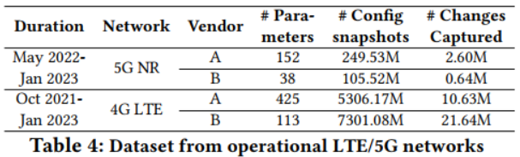
Evaluation
Database: Use a very rich dataset collected from a tier-1 cellular service provider in the United States, covering on the order of hundreds of thousands of base stations deployed nationwide. For configuration data, use 355.05 million of 5G, and 12.60 billion of LTE daily configuration snapshots.
知行合一、经世致用
自强不息 厚德载物
自强不息 厚德载物
Tsinghua University of China
Central South University
Notes:
图7：我们成功地将LTE网络的配置更改并发性降低了45%，5G网络的配置更改并发性降低了50%，我们确保我们的建议能够考虑到跨配置参数的依赖性，并使配置更改组齐头并进
如图8所示，使用无混淆数据集，供应商A超过93.75%的配置更改和供应商B超过87.5%的配置更改的分类准确率达到60%以上，这是向cell推荐此类配置更改的阈值。
图9显示了使用无混淆数据集与使用所有数据集相比，分类精度的提高。
图10显示了每个配置更改与CQI的历史平均改进的分类准确性的散点图。显然，我们希望为具有高分类精度的建议选择配置更改。

Slide 12
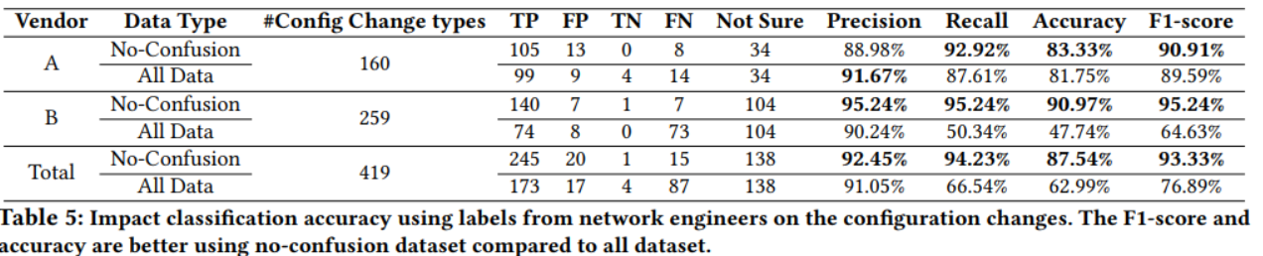
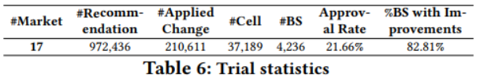
Evaluation
Table 6 shows a summary of 17 markets (recall, one or several markets combined are equivalent to a state in the US)
Overall approval rate is 21.66%
Performance improvements across 82.81% of the base stations captured using the CQI metric.
知行合一、经世致用
自强不息 厚德载物
自强不息 厚德载物
Tsinghua University of China
Central South University
Notes:
表5显示了两家供应商在所有配置更改下的结果。无混淆数据集的准确率和F1-score优于所有数据集。这证实了避免混淆影响的样本对于生成高质量的配置更改建议是很重要的。精度是TP与TP和FP之和的比值。

Slide 13
End Page

